Slide 1
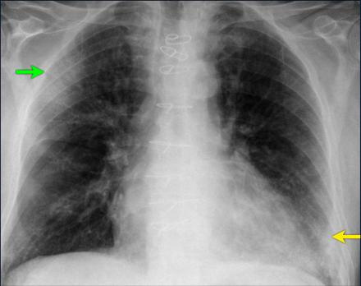
DETECTING COVID-19 IN CHEST X-RAYS USING DEEP LEARNING
Bonface Martin Oywa

Slide 2
PROBLEM
On average it takes 5 minutes to collect a single sample, and about few hours or even a day to get back results as molecular tests take time.

Slide 3


THE SOLUTION
This project is meant to help reduce this diagnosis time to under half-an hour since it takes about 15 minutes to perform an x-ray and a few seconds for a trained model to make a prediction.

Slide 4
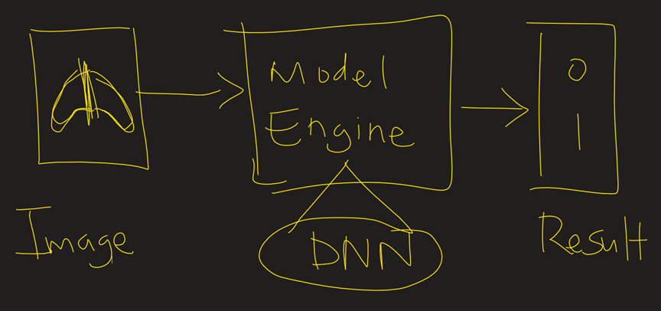

Proposed Solution Data Flow Diagram

Slide 5

COST BENEFIT ANALYSIS
What are the Pros & Cons?

Slide 6

Benefits
1
2
Reduced costs for covered persons.
It costs $60 to $100 to get tested for COVID-19 as no insurance can be used. With X-rays, insurance can be used.
Reduced diagnosis time.
4
Potentiality to reduce costs for health institutions as since procurement of testing kits may no longer be necessary.
3
Easier administering of vaccines due to possible reduced result release time.

Slide 7
Costs
1
2
Costs for a single X-ray scan for uncovered persons can be about $370 which is not favorable to all.
Procurement of sufficient X-rays Scanners may expensive for health institutions

